Slide 1

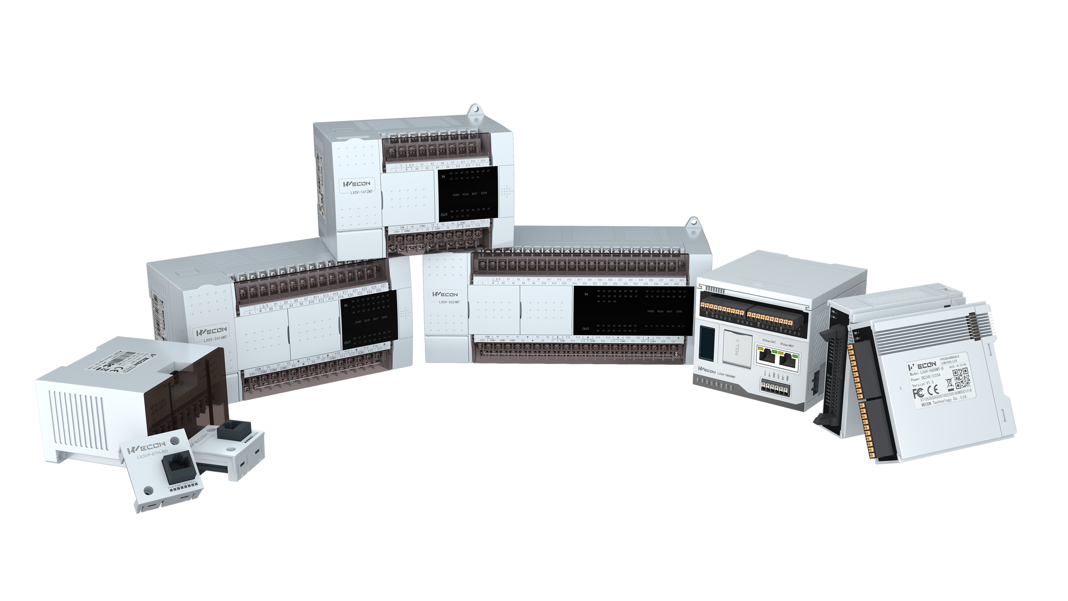

About PLC
PROGRAMABLE LOGIC CONTROLLER
WECON PLC
PLC Series
Technology & History of WECON PLC
Application
Get started
Let's Go

Slide 2
Eco PLC
Price-sensitive
No high performance required in application
LX1V
PLC Overview
Introduction
LX3V
WECON Classic PLC
Stable and reliable
Various IO and expansion
High-performance small PLC
15 times the performance of 3V
Compatible with 5V instruction set
Compatible with 3V expansion modules
LX5S
WECON is a long-standing PLC Controller manufacturer. Currently, many PLC series have been developed and released. PLC is the heart of the production process and WECON never stops developing PLC to meet the needs of the industry.
LX5V
Flagship small PLC
20-50 times the performance of 3V
Up to 8 high-speed inputs and
8 high-speed outputs.
Economical EtherCAT PLC
5MB large program capacity
EtherCAT configuration
EtherNET configuration
LX6S
LX6C
High-performance medium-size controller
Embedded I/Os
Free, manufacturer-independent CODESYS programming environment.
Modular bus PLC, small size and easy installation
4 core A53 1.8G processor
Support EtherCAT and Ethernet
LX6V

Slide 3
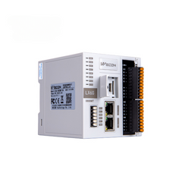

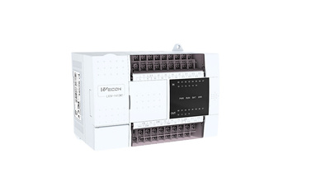
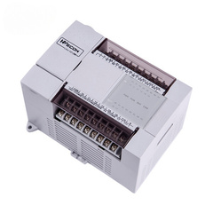
Performance
CPU
RAM
FLASH
LX6V
ARMCortex™ A53
CPU 1.8GHz x 4
2GB
DDR4
4GB
x12
x2048
x128
LX5V
ARMCortex™ M7
CPU 600MHz
1MB
x8
16MB
x16
x32
ARMCortex™ M3
CPU: 72MHz
64KB
512KB
LX3V

Slide 4
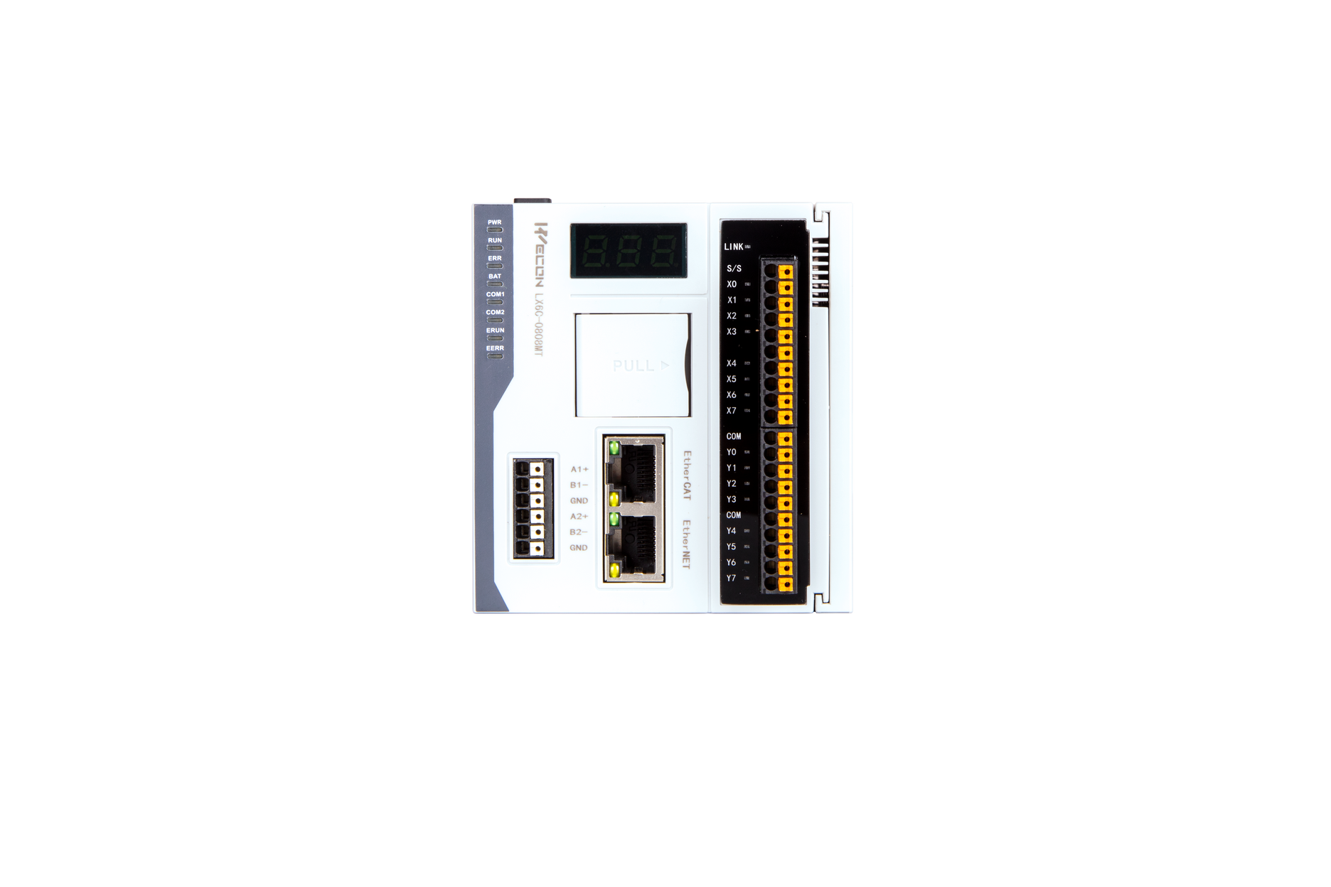
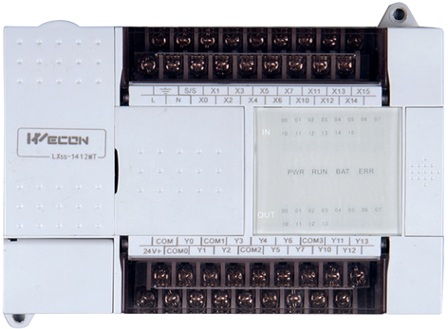
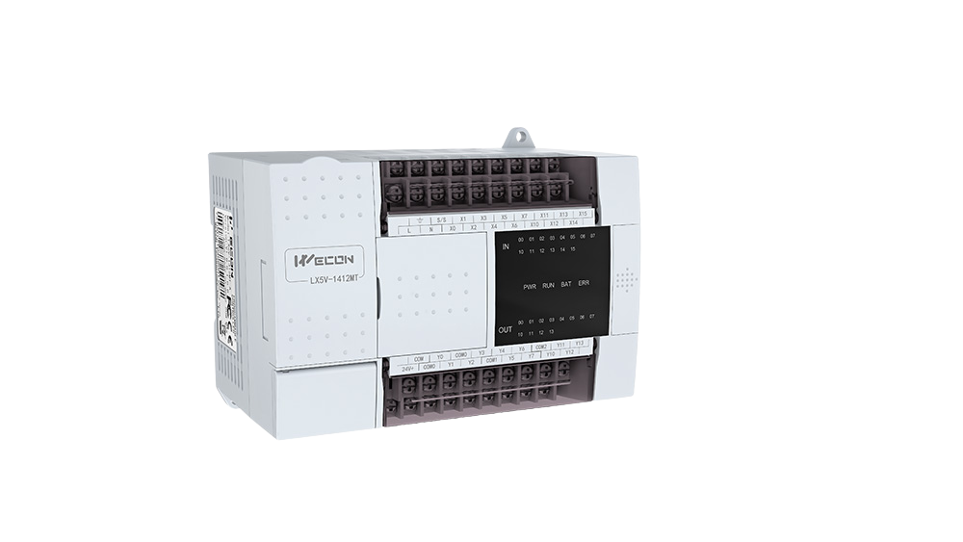
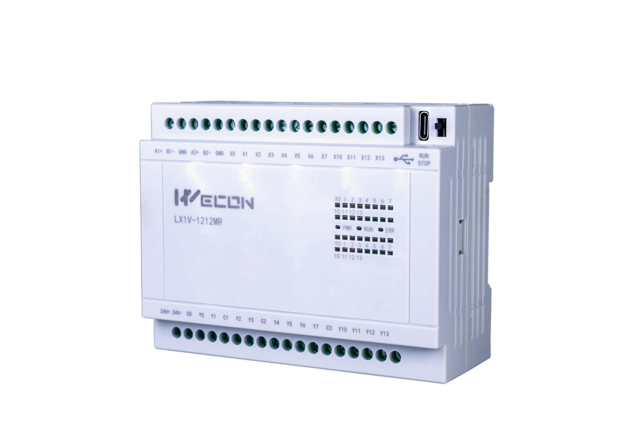

PRODUCT LINE
LX1V
LX3V
LX5V
LX6 Series

Slide 5
Communication
2 x RS485 supported Wecon protocol , Modbus RTU
LX1V
USB TYPE C
USB TYPE C for download/upload program and debugging
Economy model
Low cost project
Various application
Small scale project
Interface
Interface
Digital output type Relay
support model analog signal
High Speed Input 2 x 200KHz
DC Power supply
Up to 12DI / 12 DO
Digital output type Relay
Transistor (coming soon)
DC Power supply
Input power supply DC 24V
Features

Slide 6
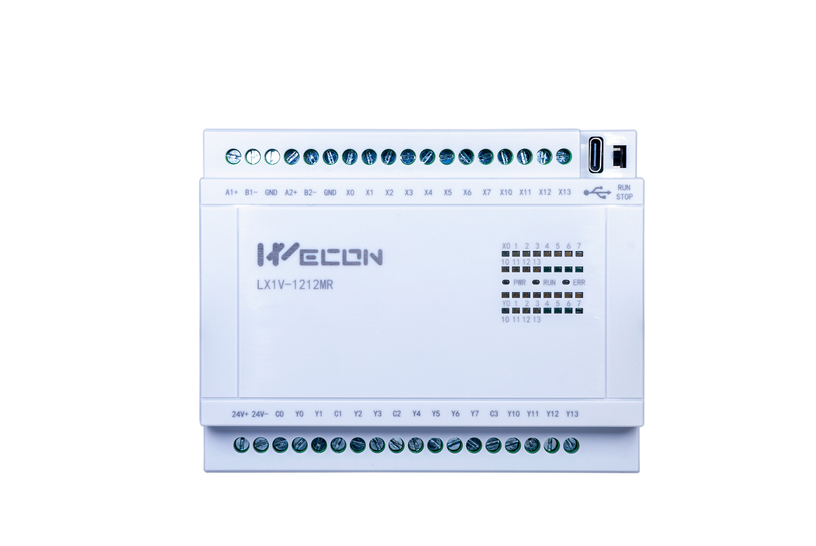
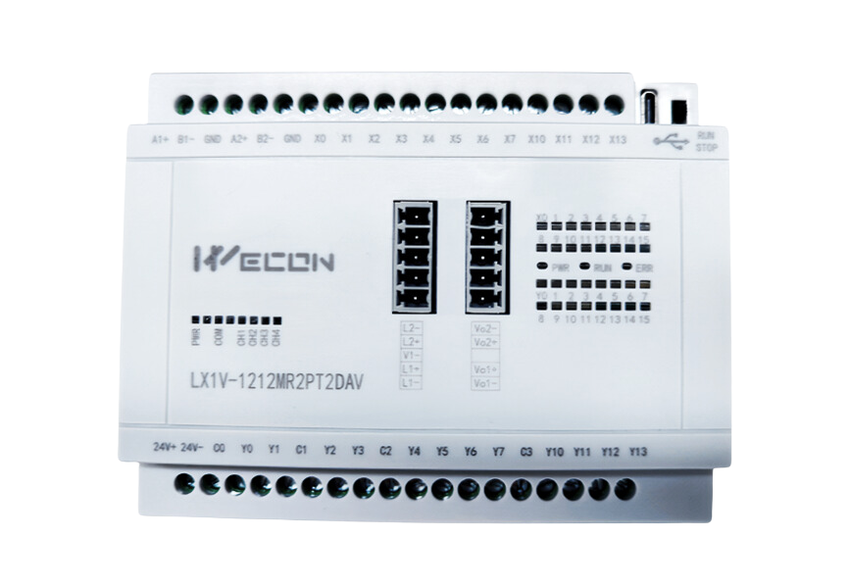
MODEL SELECTION
LX1V
Model LX1V-0806MR-D
8 DI x 6 DO (Relay)
Model LX1V-1208MR-D
12 DI x 8 DO (Relay)
Model LX1V-1212MR-D
12 DI x 12 DO (Relay)
Model LX1V-1212MR2ADI2DAI-D
12 DI x 12 DO (Relay)
2 x AI (4..20mA)
2 x AO (4..20mA)
Model LX1V-1212MR2ADV2DAV-D
12 DI x 12 DO (Relay)
2 x AI (0..10VDC)
2 x AO (0..10VDC)
Features

Slide 7



LX1V PLC
Application
Small but strong

Slide 8

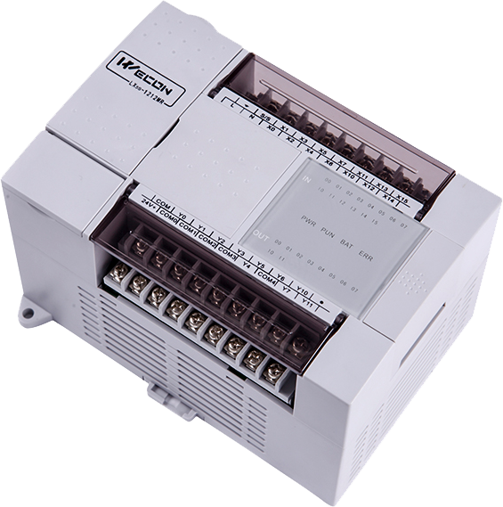
PROGRAMMABLE LOGIC CONTROLLER
LX3V SERIES
WECON Classic PLC

Slide 9





LX3V Comparison
Features
LX3V Series
N:N network
High Speed
Output
Ladder
E-CAM
Circle interpolation
LX3V
16K step
LX3VP
64K step
LX3VE (Discontinue)
32K step
LX3VM (Discontinue)
32K step

Slide 10

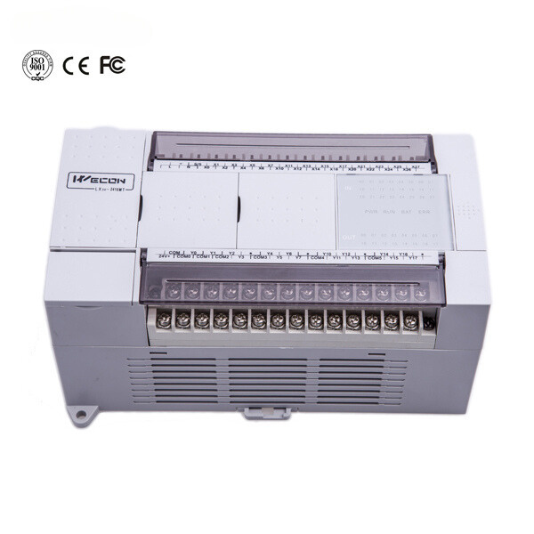

LX3VP CPU
Basic specification
Functions
Details
Running mode
Round Scan/ Interrupt
Instructions
Basic Instructions: 27 / Applied Instruction: 138
Execute time
Basic Instructions: 0.06us / Applied Instruction: 1~10us
System Storage
64K Step
High Speed Pulse Output
2 channels (Transistor)
High Speed Pulse Input
2 channels (200KHz)
Serial port
COM1 : RS422/RS485
COM2 : RS485
Power Supply
A : AC110-240V
D : DC24V (20W)
Output Mode
Relay (MR) , Transistor (MT)

Slide 11
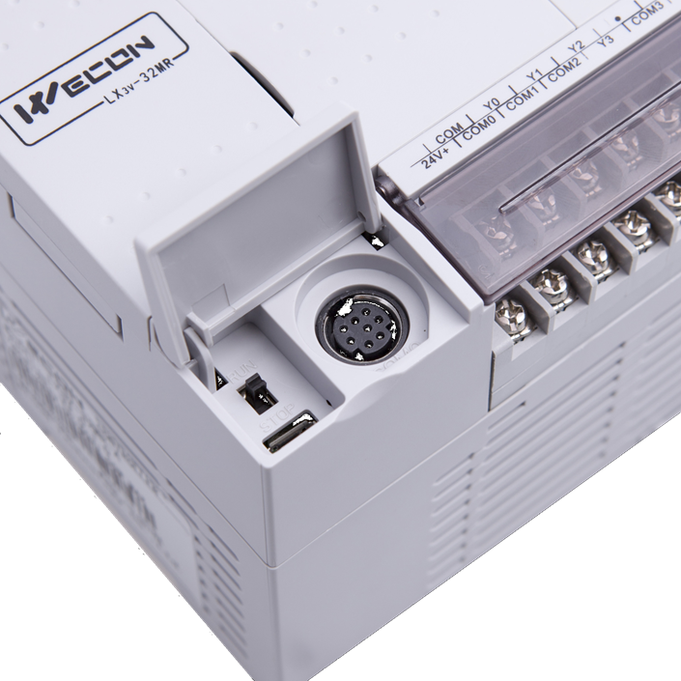
LX3V
Hardware
Interface (COM1)
RS422 , connect with HMI , V-Box
Download / Upload program
Programming port
Debugging port
Micro USB
Download / Upload program
Programming port
Debugging port

Slide 12
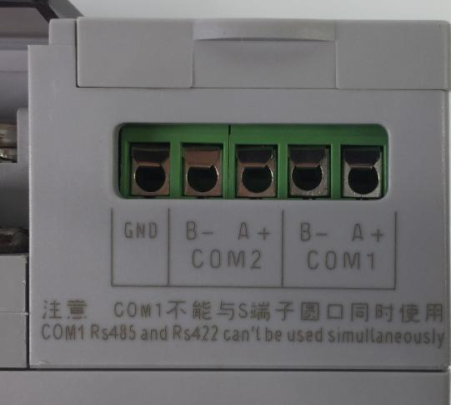
LX3V
Hardware
COM2
RS485 , connect with HMI , V-Box
Support Modbus protocol ,
User define protocol
COM1
RS485 , connect with HMI , V-Box
Download / Upload program
Programming port
Debugging port

Slide 13
PLC Selection Guide
a
PLC Series
LX3V Naming
LX3V , LX3VP , LX3VM , LX3VE
b
Input & Output
X/Y Input and output
14/12 = 14 input / 12 output
LX3V - 1412MT-A
c
General PLC
CPU Unit
a
b
c
d
e
d
Type of output
T : Transistor (NPN)
R : Relay
e
Power supply
A : AC 85..265V
D : DC 24V

Slide 14
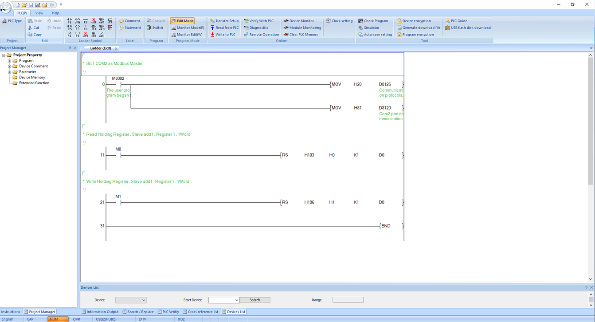




LX3V SOFTWARE
Resource
PLC Editor 1
Low resource
light weight program
Programming
Easy to start and programming
Configuration
Basic and easy to configuration for newbie
Performance
Learning curve
UI / Interface
90%
95%
85%

Slide 15
PROGRAMMABLE LOGIC CONTROLLER
LX5 SERIES
High-performance small PLC

Slide 16
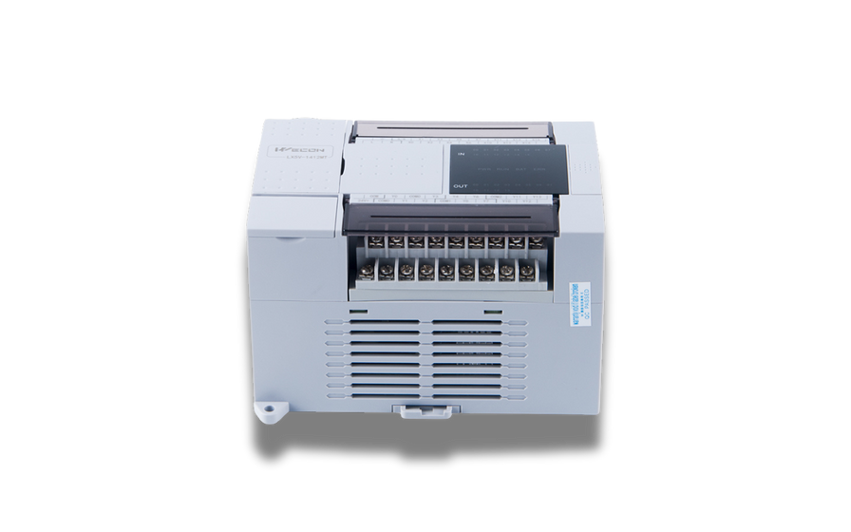
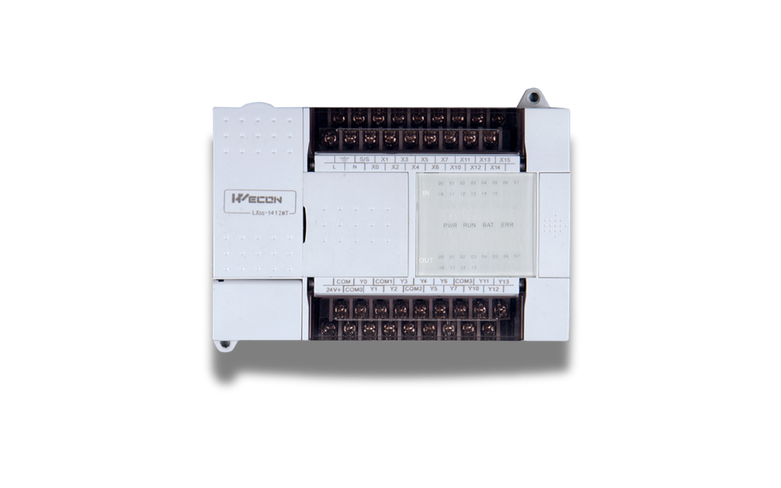
LX5 Series
Flagship
PLC
LX5V
LX5S

Slide 17
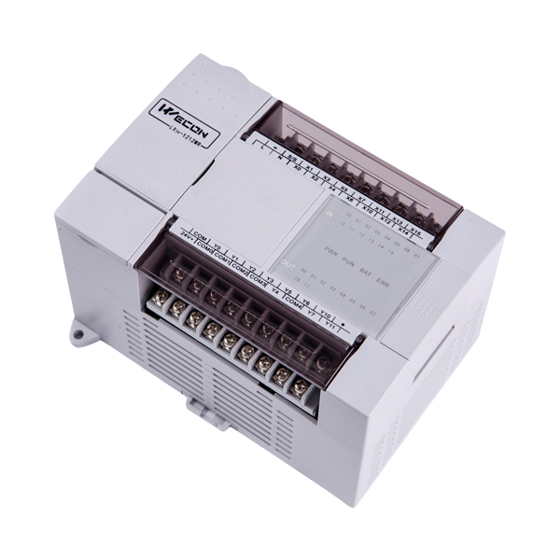
Introduction
LX5S SERIES
The PLC LX5S series is developed based on the LX3V. It is a smaller PLC with improved performance than the LX3V.
  High-performance small PLC
  15 times the performance of 3V
  Compatible with 5V instruction set
  Compatible with 3V expansion modules

Slide 18


LX5S CPU
Basic specification
Functions
Details
Running mode
Round Scan/ Interrupt / Event
Instructions
Basic Instructions: 29 / Applied Instruction: 170
Execute time
Basic Instructions: 0.03 - 0.08us
System Storage
512KB
High Speed Pulse Output
2 channels (Transistor)
High Speed Pulse Input
2 channels (150KHz)
Serial port
COM1 : RS422/RS485
COM2 : RS485
Power Supply
A : AC110-240V
D : DC24V (20W)
Output Mode
Relay (MR) , Transistor (MT)
Ethernet
Optional

Slide 19




Introduction
LX5V SERIES
  Flagship small PLC
  The fastest small PLC on the market
  20-50 times the performance of 3V
  Up to 8 high-speed inputs and outputs
High performance CPU
ARMCortex™ M7 CPU 600MHz
8 Axis motion control
up tp 8 ch high speed pulse output
Large capacity
512KB program capacity
76 KB latched capacity
76 KB register capacity

Slide 20
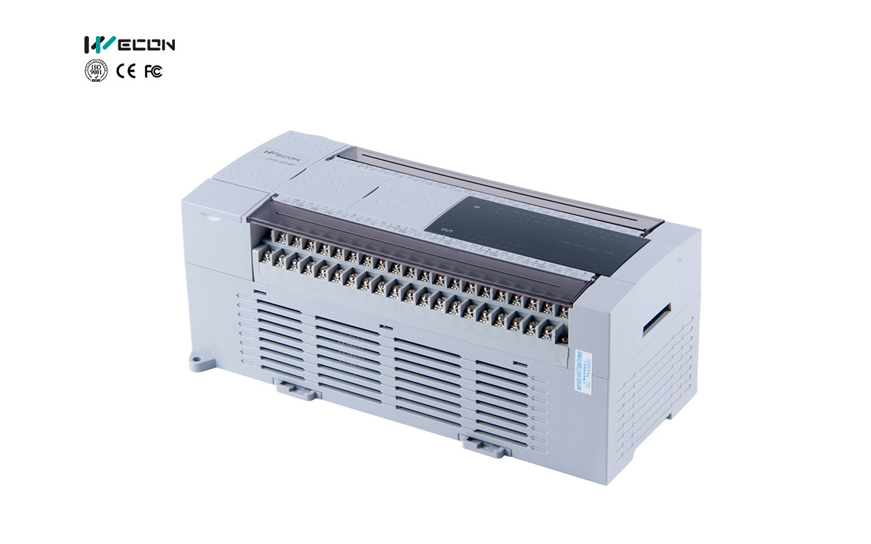
LX5V CPU
Basic specification
Functions
Details
Running mode
Round Scan/ Interrupt / Event
Instructions
Basic Instructions: 29 / Applied Instruction: 170
Execute time
Basic Instructions: 0.01 - 0.03us
System Storage
512KB
High Speed Pulse Output
8 channels (above CPU 16/16)
High Speed Pulse Input
4 channels (150KHz)
Serial port
COM1 : RS422/RS485
COM2 : RS485
Power Supply
A : AC110-240V
D : DC24V (20W)
Output Mode
Transistor (MT)
Ethernet
Optional

Slide 21
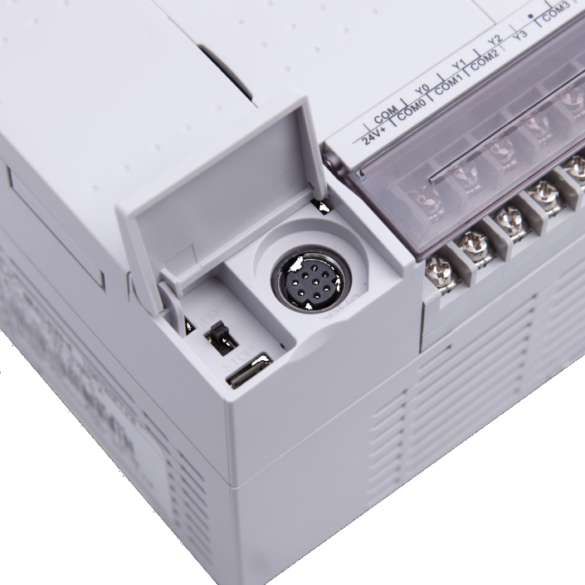
LX5V
Hardware
Interface (COM1)
RS422 , connect with HMI , V-Box
Download / Upload program
Programming port
Debugging port
Micro USB
Download / Upload program
Programming port
Debugging port
Hardware

Slide 22
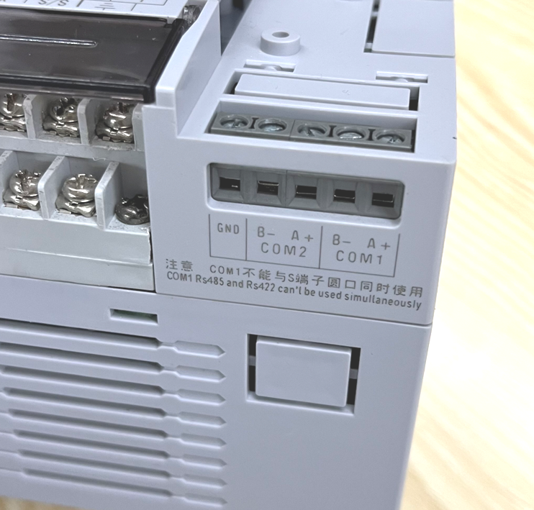
LX5V
Hardware
COM2
RS485 , connect with HMI , V-Box
Download / Upload program
Programming port , Debugging port
Support Modbus protocol , User define protocol
Support PLC-LINK Protocol
COM1
RS485 , connect with HMI , V-Box
Download / Upload program
Programming port
Debugging port

Slide 23
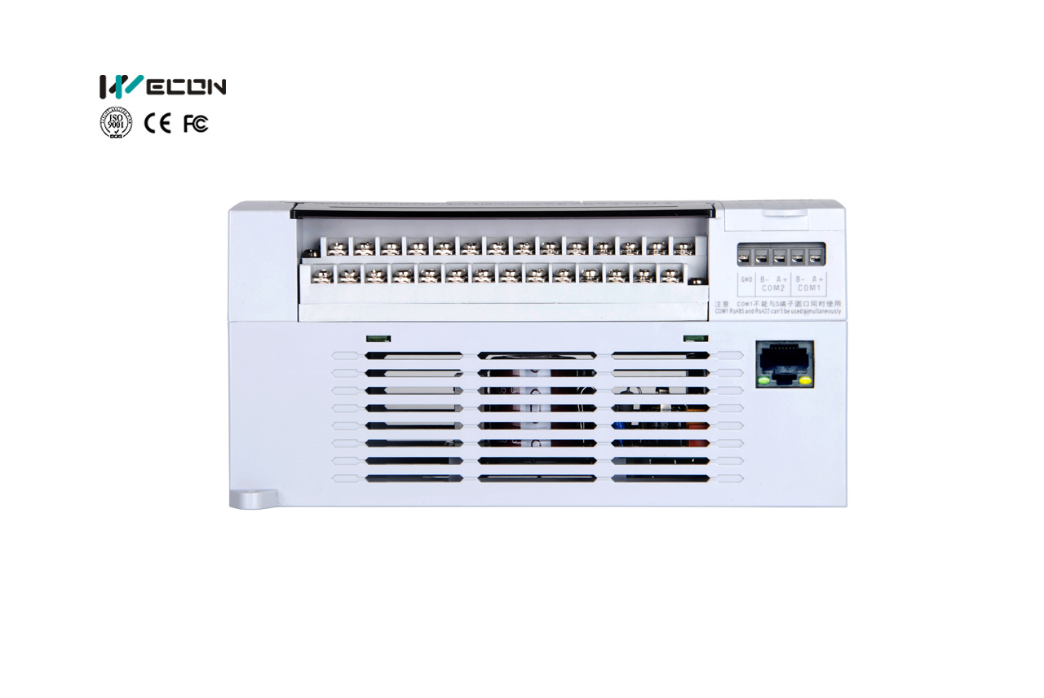
LX5V
Hardware
Ethernet Port (N model)
Connect with HMI , V-Box
Download / Upload program
Programming port , Debugging port
Support Modbus TCP/IP ,
TCP/IP Socket

Slide 24
PLC Selection Guide
a
PLC Series
LX5V Naming
LX5V, LX5S
b
Input & Output
X/Y Input and output
14/12 = 14 input / 12 output
LX5V - 1412MT-DN
c
General PLC
**
CPU Unit
a
b
c
d
e
d
Type of output
T : Transistor (NPN)
R : Relay
e
Power supply
A : AC 85..265V
D : DC 24V
** N - Option Ethernet port interface

Slide 25
LX5S-0806MT/MR
8 x DI , 6 x DO
PLC MODEL
LX5S SERIES
LX5S-1208MT/MR
12 x DI , 8 x DO
LX5S-1412MT/MR (AN/DN)
14 x DI , 12 x DO
LX5S-1616MT/MR (AN/DN)
16 x DI , 16 x DO
LX5S-2416MT/MR (AN/DN)
24 x DI , 16 x DO
LX5S-2424MT/MR (AN/DN)
24 x DI , 24 x DO
LX5S-3624MT/MR (AN/DN)
36 x DI , 24 x DO

Slide 26
PLC MODEL
LX5V-1412MT (AN/DN)
LX5V SERIES
14 x DI , 12 x DO
LX5V-1616MT (AN/DN)
16 x DI , 16 x DO
LX5V-2416MT (AN/DN)
24 x DI , 16 x DO
LX5V-2424MT (AN/DN)
24 x DI , 24 x DO
LX5V-3624MT (AN/DN)
36 x DI , 24 x DO

Slide 27
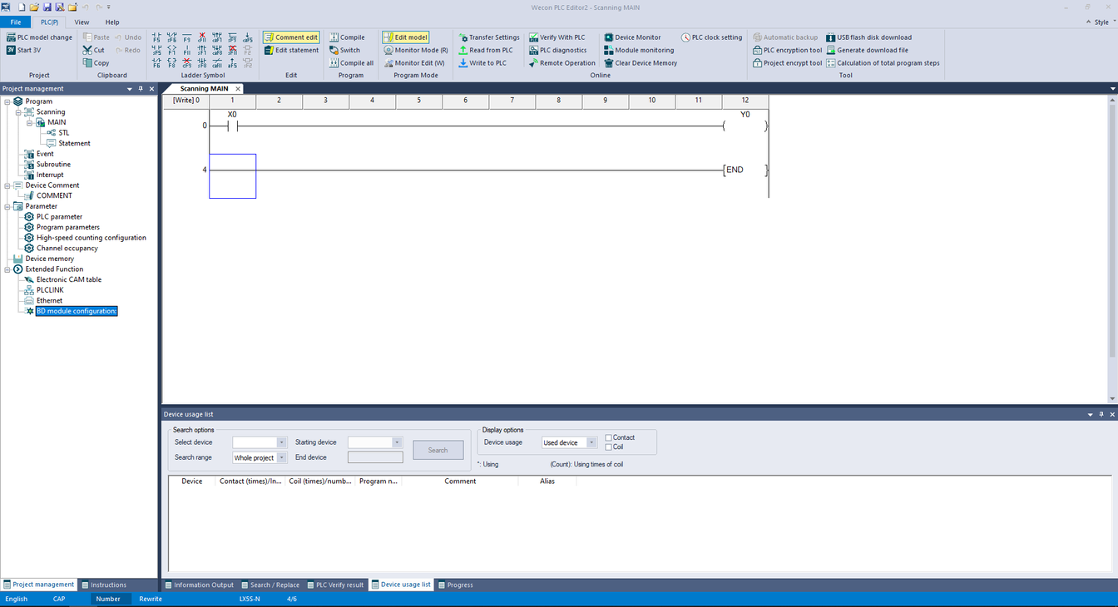


LX5/LX6V/LX6S SOFTWARE
Programming
PLC Editor 2
Easy to start and programming
New design UI interface
Nice design interface
User friendly
Configuration
Easy configuration network
User interface configuration
EtherCAT / Ethernet config support
Performance
Learning curve
UI / Interface
95%
95%
95%

Slide 28
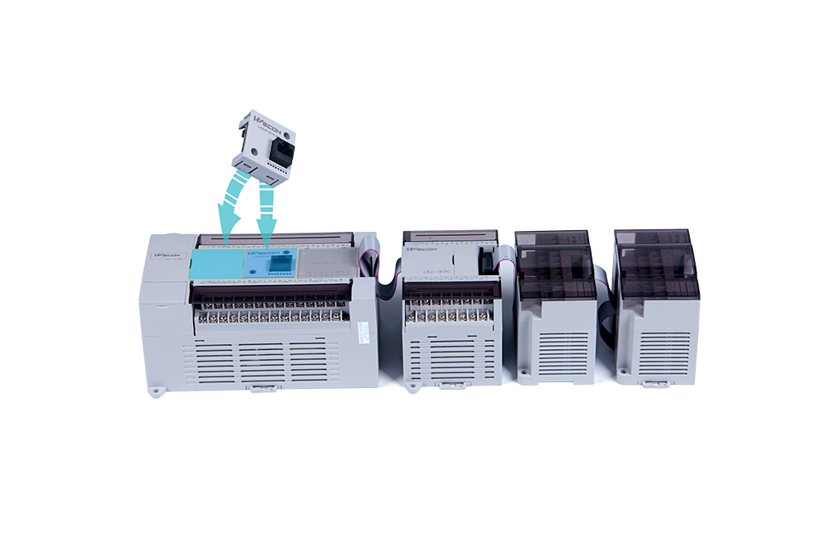
PROGRAMMABLE LOGIC CONTROLLER
Expansion module
BD board
High-performance small PLC

Slide 29
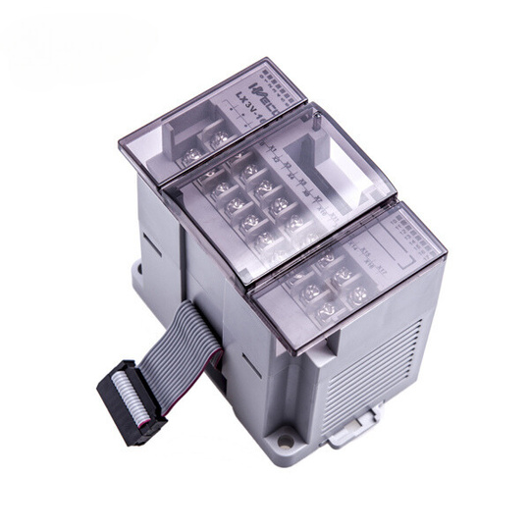
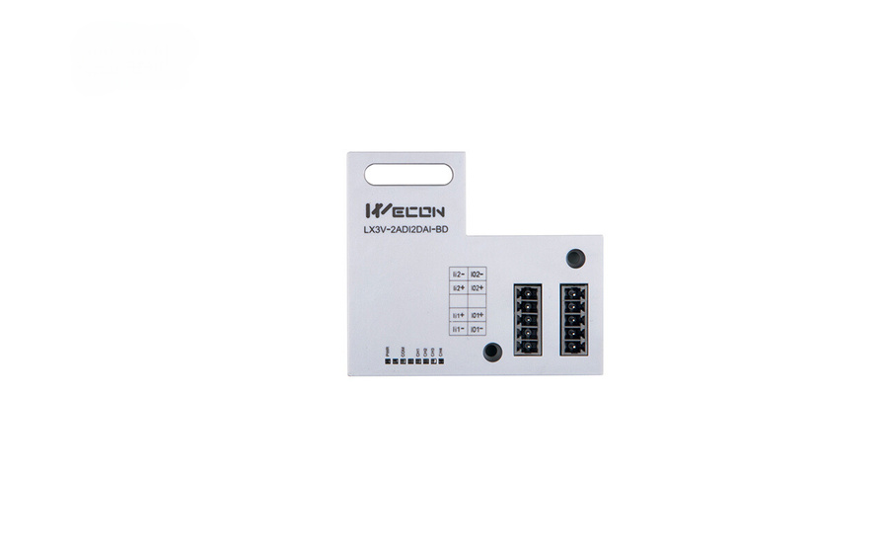
PLC Expansion module
Module & Board
WECON PLC has standard industrial signal modules and receiver boards supporting them, including temperature sensors, standard analog signals, digital signals, and load cell sensors.
MODULE
BD Module
3V/5V Series
3V/5V Series
Analog / Digital
Temperature
Remote
Weighing
Analog / Digital
Temperature
Communication

Slide 30




Type of expansion module
There are many types of WECON expansion modules to support the expansion of various applications. According to the standards of industrial control applications, there are many signal formats available.
Temperature
Analog
Temperature module is supported various sensors like a thermocouple , RTD.
Analog module support signal standard current and voltage.
Key Modules
Temperature
LX3V-4PT , LX3V-4TC , LX3V-4LTC
Analog
LX3V-4AD , LX3V-4DA
Digital
LX3V-16EX , LX3V-16EYT/R
Weighing
LX3V-1WT, LX3V-2WT
Digital IO
Weighing
Pulse output
LX3V-4PG
For application that apply many digital sensors or discrete output it can scale up by digital I/O modules.
Wecon modules are supported weighing.

Slide 31


PLC Expansion module
Maximum module
LX3 and LX5 series PLC can support up to 16 expansion modules, but it mainly depends on the CPU used, and the power supply to the additional modules must be calculated.
Support up to 16 modules for multi-module connection
Noted : analog module need auxiliary power supply
I/O
LX3 series: Maximum IO 256 points
LX5 series: Maximum IO 1024 points

Slide 32
Module Selection Guide
a
Module Series
LX3V Module Naming
LX3V
LX3V - 4AD
b
Number of channel
4 channels, 8 channels, 16 channels
a
b
c
c
Function of modules
Analog, temperature, weighing and so on.
All LX3V module could be used with LX5 series PLC

Slide 33
Module Selection Guide
a
LCM Module
LCM Module Naming
Remote Module
LCM - 4TC
b
Number of channel
2 channels, 4 channels, 16 channels
a
b
c
c
Function of modules
Digital, weighing, temperature
LCM module is a standard Modbus RS485 slave

Slide 34
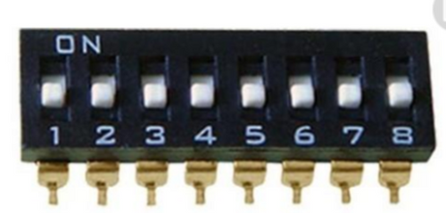
Module Selection Guide
The DIP switch on the module is used to set communication parameters such as station number and baud rate.
LCM Module Naming
LCM - 4TC
LCM-16EX
16 x Digital output
a
b
c
LCM-16EY
16 x digital output
LCM-2WT
2 x weighing sensor , 24-bit resolution
LCM-4TC
4 x Thermocouple (K,J)
LCM module is a standard Modbus RS485 slave

Slide 35
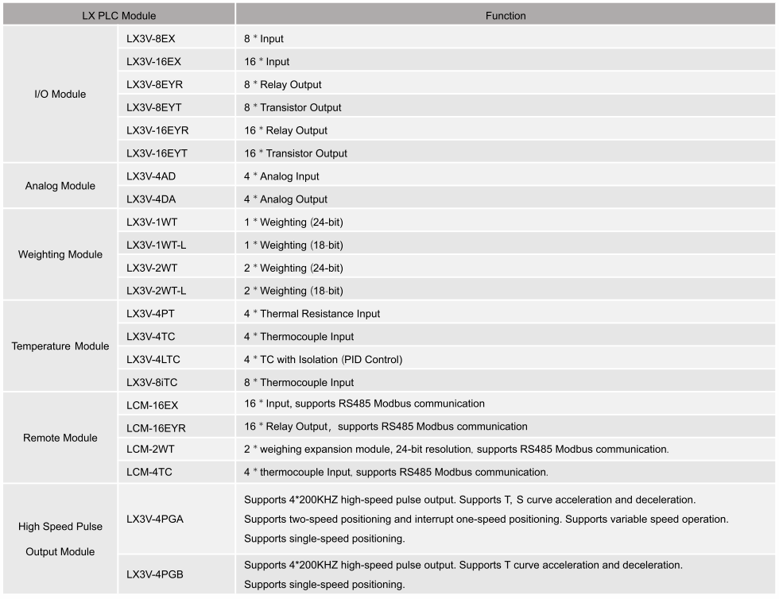
Module Selection Guide
Module list

Slide 36
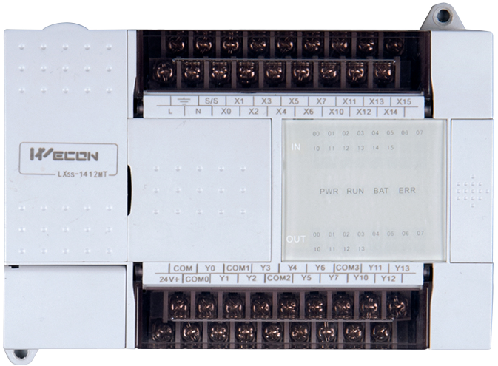

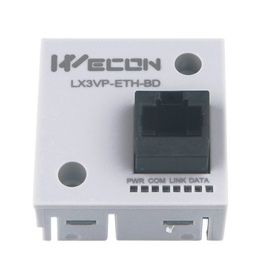
PLC BD module
BD Module
The BD module is an expansion module installed on the top of the PLC, which is more compact and saves space.

Slide 37
BD Module Selection Guide
a
BD Series
BD Module Naming
LX3V , LX5V
b
Number of channel
2 channels , 4 channels
LX3V - 2AD2DA-BD
c
Function of BD modules
Analog , temperature
a
b
c
b
c
d
d
Module type
BD Board

Slide 38
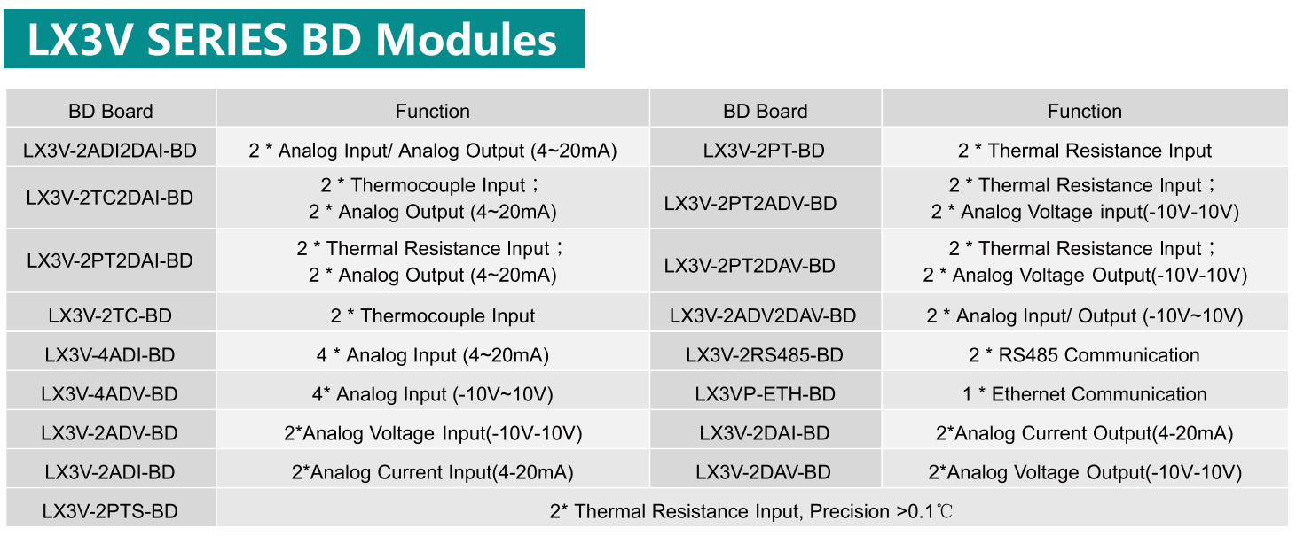
BD Module Selection Guide
BD Module list

Slide 39
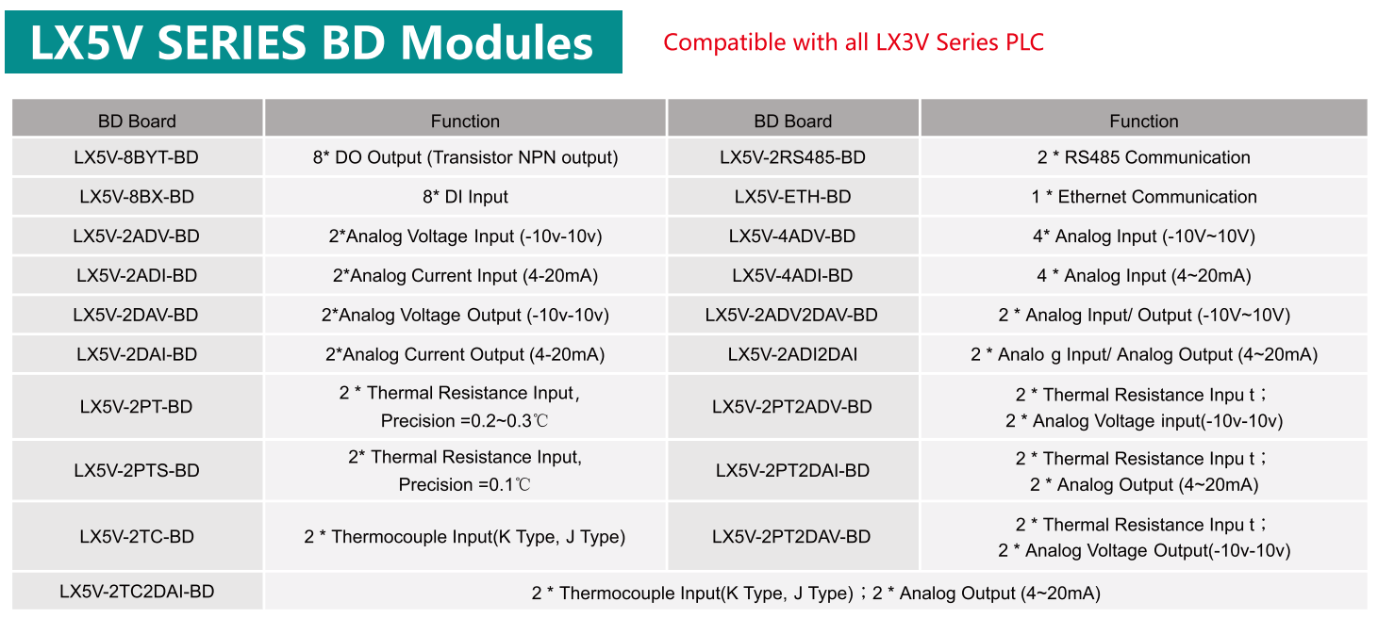
BD Module Selection Guide
BD Module list

Slide 40






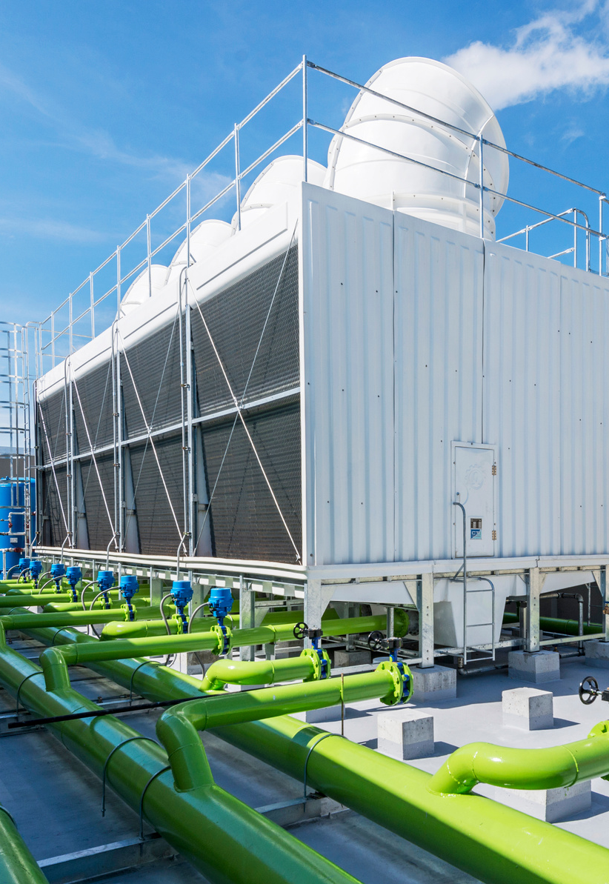
LX3V / LX5V
APPLICATION
Machine
Assambly
Robot
Agriculture
Process
Utility

Slide 41



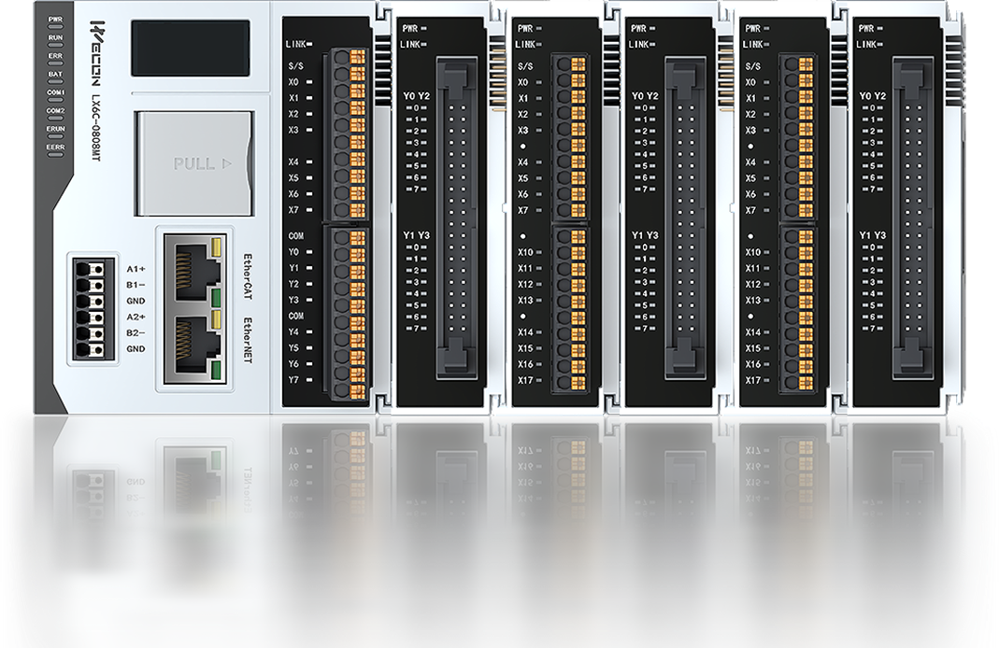
LX6 SERIES
New Gen of
WECON PLC
High-performance Medium-size Controller

Slide 42
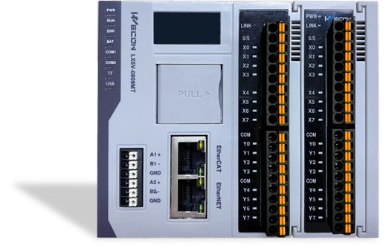

LX6V
Product Line
High performance bus type PLC
Self-developed system.
Excellent performance,
Meet the needs of various industrial buses and customization needs
LX6 Series
LX6C
PLC based on codesys platform.
Highly optimized for general use and mature programming methods.
Easy-use and highly versatile.
LX6S
Economical PLC Based on Bus Application.
Applications below 16 axes have a price advantage.

Slide 43
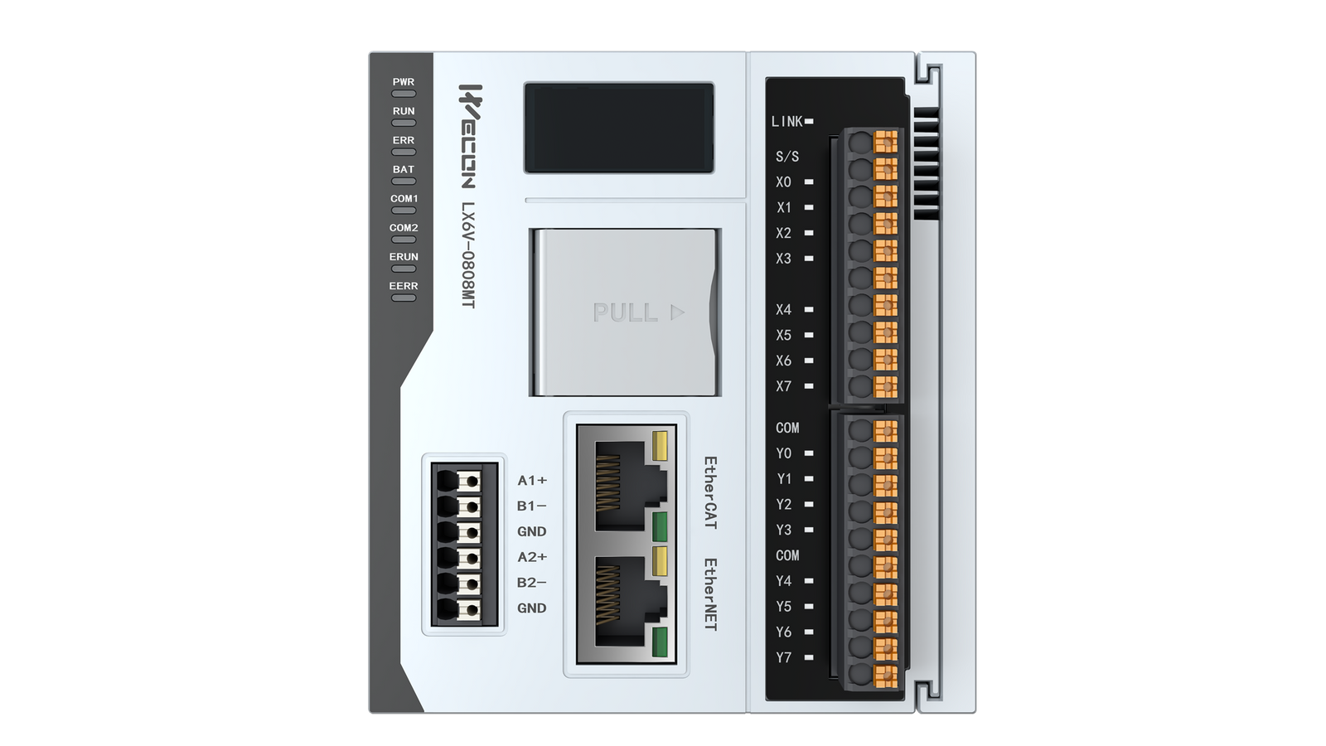
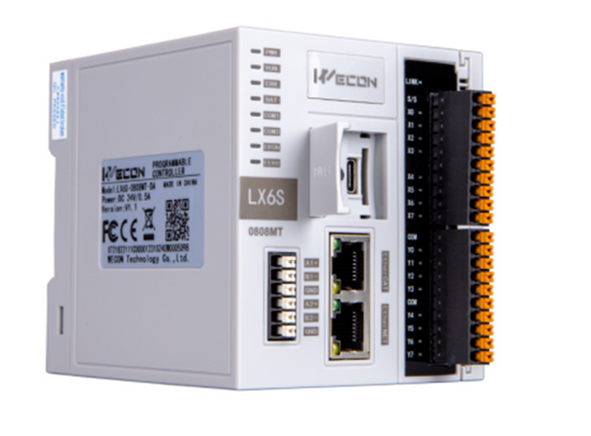
LX6V/LX6S Comparsion
Basic specification
Series
LX6V
LX6S
Programming
LD/FB/FC
Execute time
0.01-0.02μs
Program capacity
5MB
System Storage
EMMC
Flash
High Speed Pulse Output
4 channels/200KHz
High Speed Pulse Input
8 ch 150KHz
4 ch 200KHz
High Speed Input AB
4 ch 100KHz
4 ch 150KHz
Ethernet
1000Mbps
100Mbps
EtherCAT
Max. 128 Axis
Max. 16 Axis
LED Display
Yes
N/A

Slide 44
LX6V / LX6S
Model Selection
Model
I/O
E-CAM
Pulse input
Pulse output
Axis
LX6V-0808MT-DB
8
YES
8
4
16
LX6V-0808MT-DD
8
YES
8
4
64
LX6V-0808MT-DE
8
YES
8
4
128
LX6S-0808MT-DA
8
YES
4
4
8
LX6S-0808MT-DB
8
YES
4
4
16

Slide 45
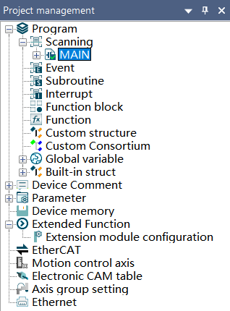





PLC Editor2 Software
Newly designed free-tag agreement
Easy Ethernet/EtherCAT configuration
structure, array variable definition
Motion Control
Support cam, interpolation ,superposition, etc.
Self-definded FB/FC

Slide 46
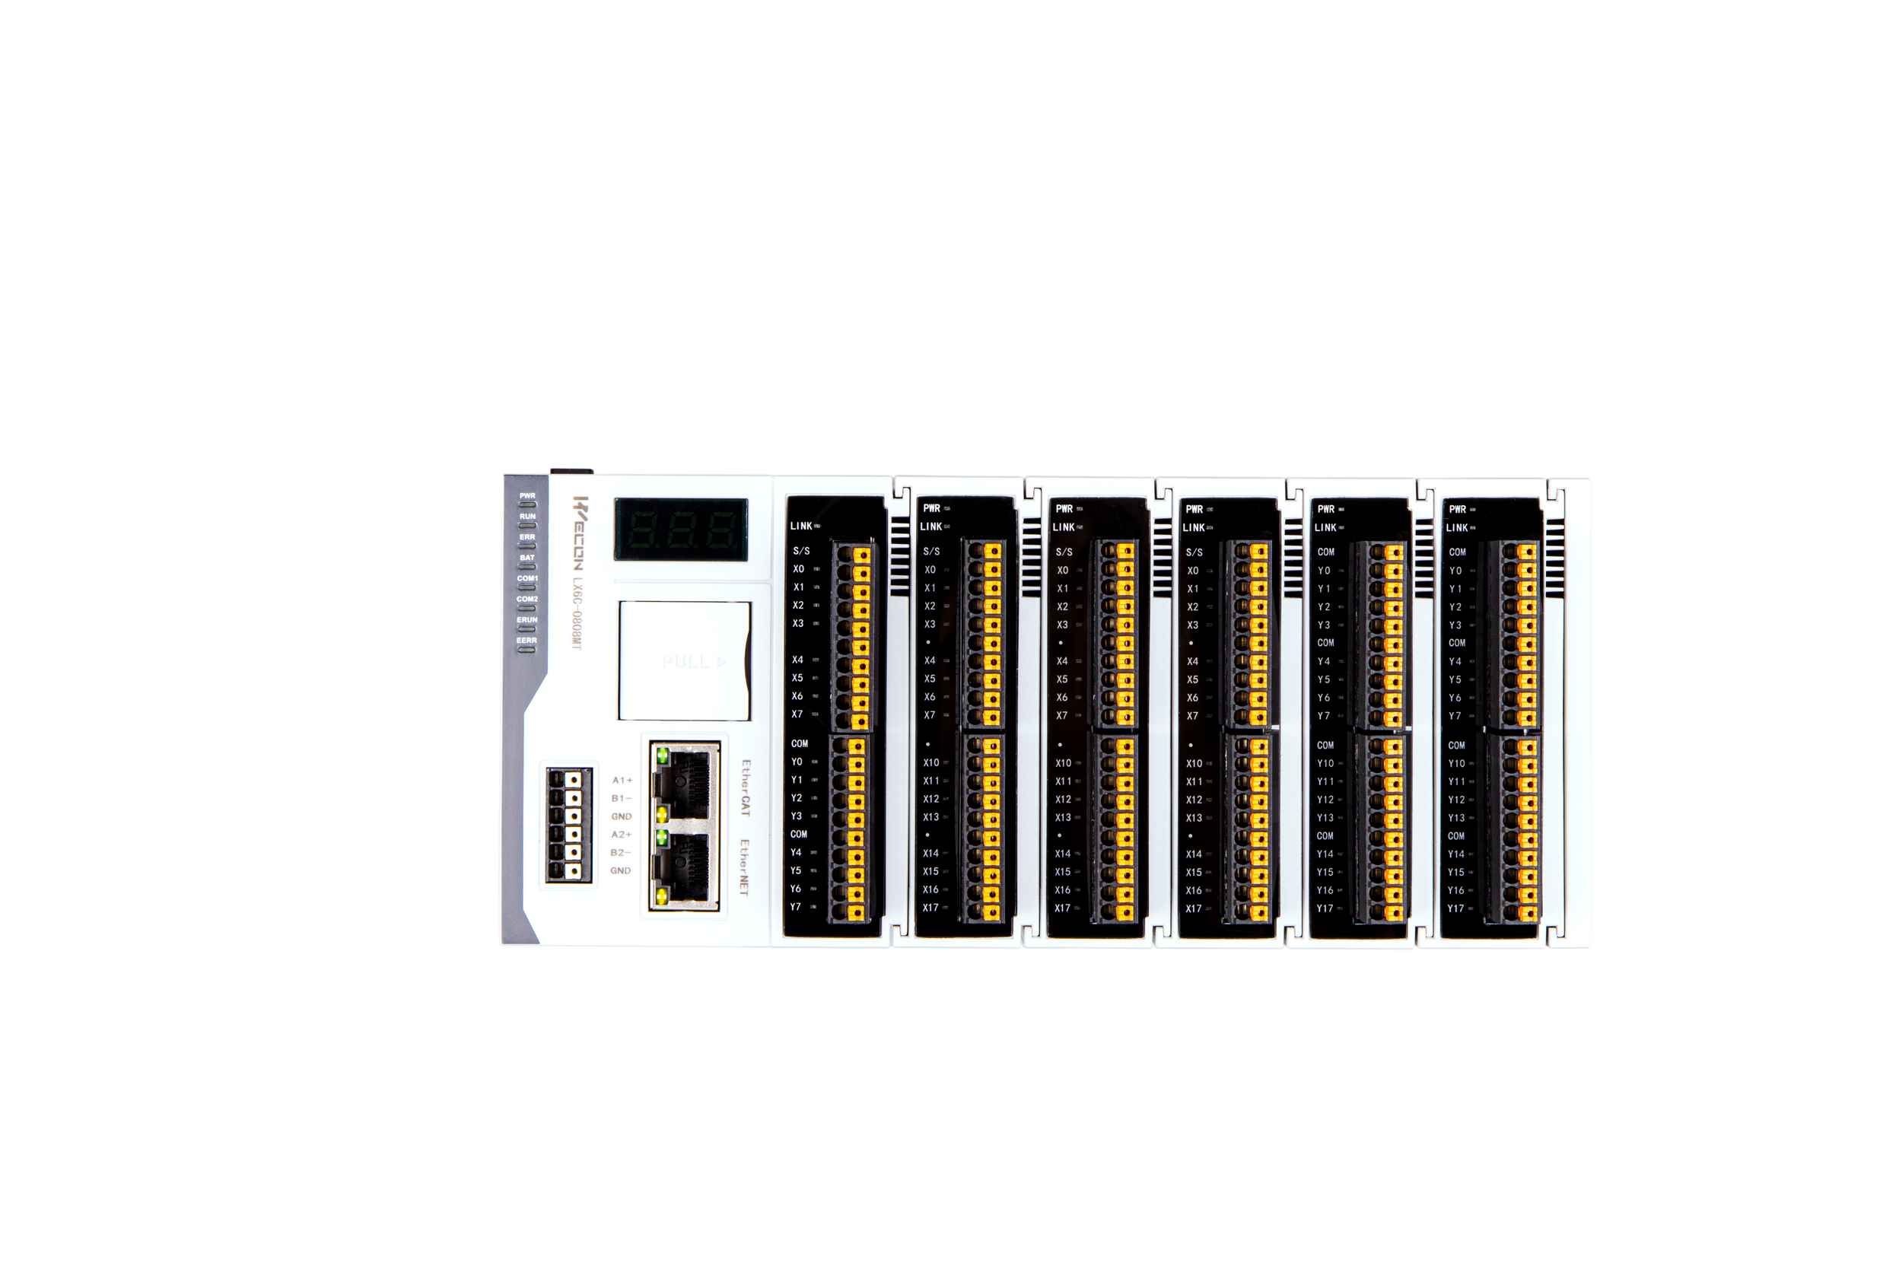

LX6C PLC
High-performance Medium-size Controller
New Era Wecon PLC

Slide 47
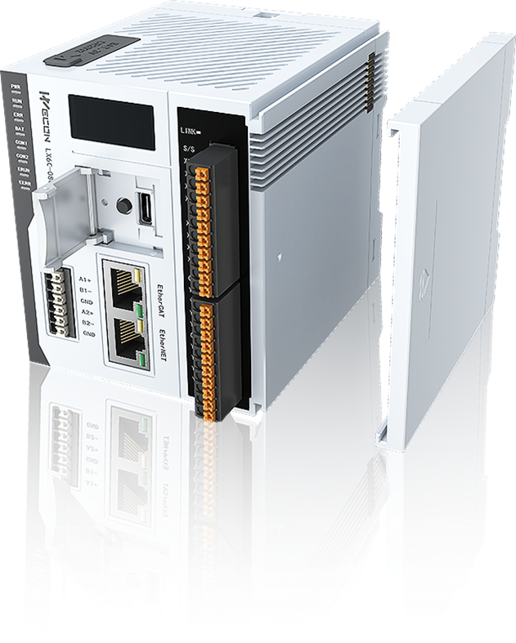






Key Features
Program Execution
Motion Control
Efficient execution & Multitasking managemen
MC + CNC + Robotics, meet various motion control needs
Expansion Module
Project Development
100us communication cycle, flexible installation
Standard instructions, motion control instructions, multi-language, modular
Communication Protocol
Operation & Maintenance
Standard Gigabit Ethernet, support multi-protocol interconnection
Remote debugging at home, save time and labor costs

Slide 48



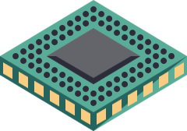

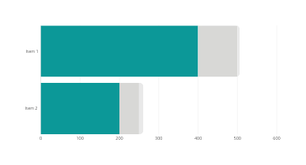
Superior Speed CPU
Program Execution
x50
4-core 1.8GCPU boosts instruction processing speed.
ns-level basic instruction execution speed.
80 %
5ns
80% increase in performance more than traditional PLC
CPU Processing times 5ns per instruction
2.3 µs
For traditional flag ship PLC in the market
80 %
x50
Performance

Slide 49


Efficient multitasking system
Program Execution
Multitasking management system: Set the execution mode, frequency, and priority of different tasks to achieve efficient use of system resources
MAIN
Cyclic
Freewhe-eling
Cyclic
Freewhe-eling
Event

Slide 50







Untimate Operation Control
Buffer mode
Motion Control
Speed continuous transition, easy to deal with multiple speed control
Single-Axis motion control
Speed control
Movement superposition
Haming control
Position control
Torque control
Compensate for the error between mechanical vibration and axis
Multi-axis motion control
Speed sync
Robot
Quadratic sinusoidal acceleration
ECAM
Multi-axis
interpolation
Application function
Position sync
CNC
Acceleration continuous transition, smooth and stable mechanical movement
Rotary cut
Touch probe

Slide 51
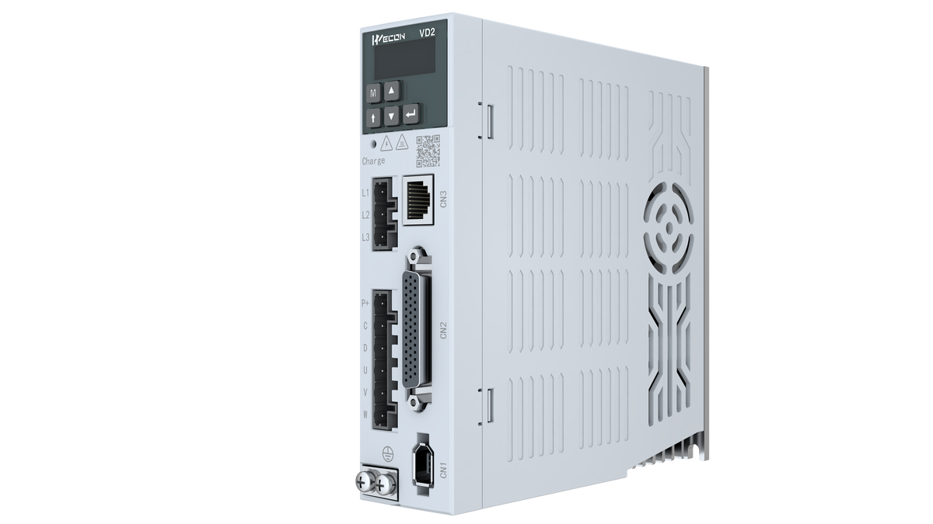

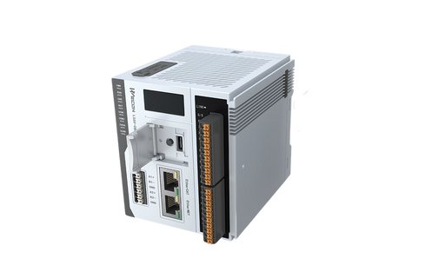
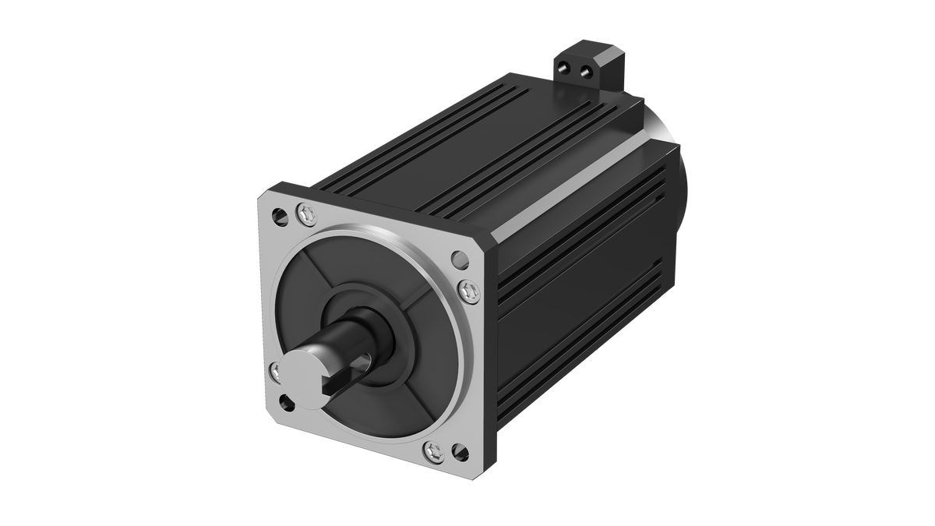



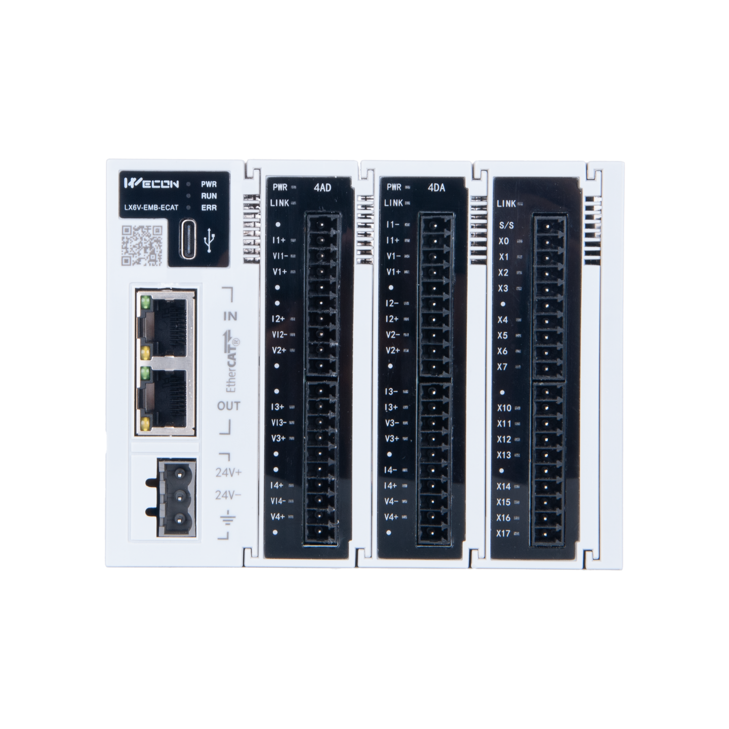
Perfectly And Reliability
Operation & Maintenance
Easily remote debugging and upgrade in V-NET System
Servo Systems
HMI
V-NET
PC
EtherCAT Coupler
LX6C

Slide 52















PC
Instruments
SEAMLESS CONNECTIVITY
Communication Protocol
Support Multi-Protocol base on Ethernet TCP/IP
Servo Systems
Remote I/O
HMI
Presented By
ESO TECH CO.,LTD

Slide 53
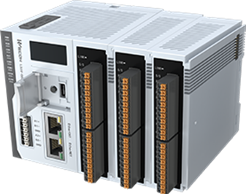

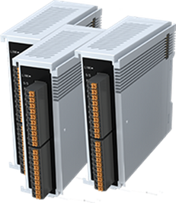
Scale At High Speed
Expansion Module
Support local expansion modules up to 32 modules
DI/DO , Analog , Temperature(developing)
High speed communication
Free optional
Blade structure
  Quick response
  Flexible matching to meet needs
  Easy to install and save space

Slide 54
Scale At High Speed
Expansion Module
Support local expansion modules up to 32 modules
DI/DO , Analog , Temperature(developing)
Expansion module type and model |  | Function
Digital input/output | LX6V-16EX | 16 input module
 | LX6V-16EYT | 16 transistor output module
 | LX6V-0808EXYT | 8-way input, 8-way transistor output module
Analog input/output | LX6V-4AD | 4-way analog input module
 | LX6V-4DA | 4-way analog output module
Communication | LX6V-EMB-ECAT | Support up to 16 devices

Slide 55
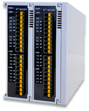
Remote module Solution
EtherCAT Coupler
LX6V/LX6S/LX6C
Max. 128
LX6V-EMB-ECAT
(EtherCAT Coupler)
LX6 I/O Module
Max. 16

Slide 56
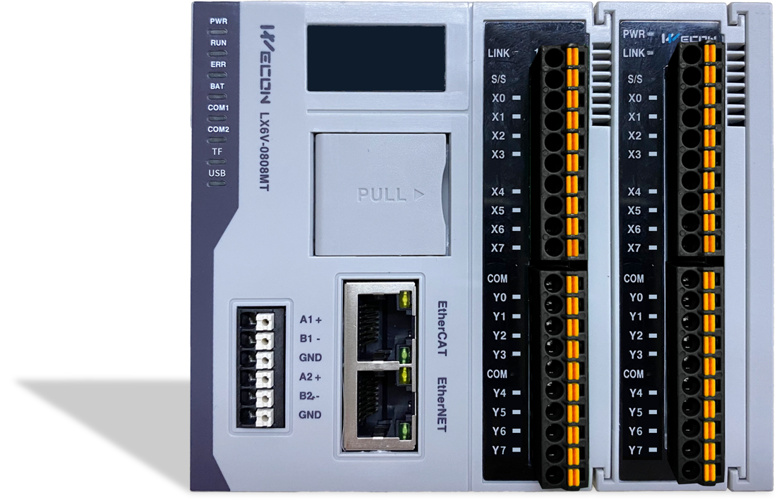


Digital display
LX6
Status and diagnostic CPU
Hardware
Expansion module
Up to 32 modules per CPU unit
Status Indicator
Local I/O with status
USB TYPE-C / TF Card
8 x High speed single phase input
4 x High speed pulse output
Upload/download/monitoring program;
Program download, user data record(developing);
EtherCAT
RS485 (COM1-2)
up to 128 servo axis , Thrid party devices
COM1: Modbus RTU/ASCII protocol
COM2: User-define protocol
Modbus RTU/ASCII
Ethernet
Support Modbus TCP

Slide 57


PROGRAMMING
SOFTWARE
CODESYS® is the leading manufacturer-independent IEC 61131-3 automation software for engineering control systems.
CODESYS Group | We software Automation.

Slide 58


CODESYS ENGINEERING
SOFTWARE
Profressional Engineering of IEC 61131-3 Automation projects
  Ladder diagram (LD)
  Sequential Function Charts (SFC)
  Function Block Diagram (FBD)
  Structured Text (ST)
  Instruction List (IL)

Slide 59



CODESYS
MOTION + CNC
Logic and motion control in a single IEC 31131-3 system
Development kit for project engineering , from motion applications to CNC/robot control

Slide 60

LX6C
Specifications

Slide 61

LX6C
Specifications

Slide 62
LX6C
Specifications

Slide 63
LX6C Model Selection
Model | Function
LX6C-0808MT-D0 （developing） | Quad-core A53 1GHz processor;Basic PLC functionality;8 channels of digital input (DI);8 channels of NPN digital output (DO);Supports 4-axis local pulse input&output
LX6C-0808MT-DA （developing） | Quad-core A53 1GHz processor;Basic PLC functionality;8 channels of digital input (DI);8 channels of NPN digital output (DO);Supports 4-axis local pulse input&output;Communication protocols: Modbus, Modbus TCP, EtherNET/IP, EtherCAT Master
LX6C-0808MT-DB | Quad-core A53 1.2GHz processor;Digital status indicators;Basic PLC functionality;8 channels of digital input (DI);8 channels of NPN digital output (DO);Supports 4-axis local pulse input and 4-axis local pulse output;Communication protocols: Modbus, Modbus TCP, EtherNET/IP, EtherCAT Master; Supports CNC + Robotics
LX6C-0808MT-DC | Quad-core A53 1.8GHz processor; Digital status indicators; Basic PLC functionality;8 channels of digital input (DI);8 channels of NPN digital output (DO);Supports 4-axis local pulse input & output; Communication protocols: Modbus, Modbus TCP, EtherNET/IP, EtherCAT Master; Supports CNC + Robotics, Webvisu
LX6C-0808MT-DD | Quad-core A53 1.8GHz processor; Digital status indicators; Basic PLC functionality; 8 channels of digital input (DI); 8 channels of NPN digital output (DO); Supports 4-axis local pulse input & output; Communication protocols: Modbus, Modbus TCP, EtherNET/IP, EtherCAT Master; Supports CNC + Robotics, Webvisu, Multicore 4 Cores, and OPC UA Server

Slide 64



LX6V / LX6S / LX6C
Applications
LX6 Series controllers are high performance programmable logic controller that designed for reliable and widely used system for industrial automation.
3
Highlights Solutions
  Process control
  High-end Machine
  Robot & Motion control

Slide 65

LX6V / LX6S / LX6C
Applications
LX6 Series controllers are high performance programmable logic controller that designed for reliable and widely used system for industrial automation.
3
Highlights Solutions
  Process control
  High-end Machine
  Robot & Motion control

Slide 66






THANK YOU
CONTACT US TO LEARN MORE
Phone
Email
Online
400-799-8189
sales@we-con.com.cn
www.we-con.com.cn/en

